Slide 1

SIMULATION AND EXPERIMENTAL ANALYSIS OF PULL-TYPE ORDERING METHODS:
THE BULLWHIP EFFECT
J. PEREIRA, F. PAREDES
Faculty of Engineering, Universidad Diego Portales, Santiago de Chile
C. LAVIN, L.S. CONTRERAS-HUERTA, C. FUENTES,
Faculty of Psychology, Universidad Diego Portales, Santiago de Chile

Slide 2




Motivation
Beer Distribution Game (Supply Chain Structure):
L
factory
wholesaler
retailer

Slide 3
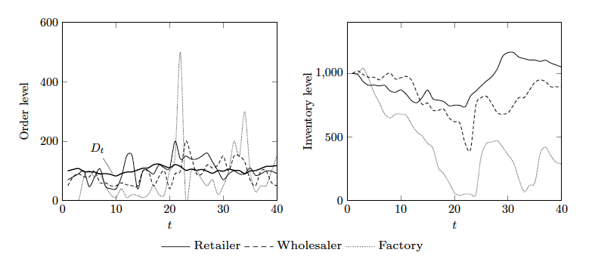
Motivation
Behavioural Experiment
Figure 1. Amplification (bullwhip effect) of orders and inventory levels

Slide 4
Motivation
  [Lee et al. 2000; Takahashi and Myreshka, 2004; Warburton 2004; Pereira et al., 2009]
  MAIN REASONS OF BULLWHIP-EFFECT:
  Demand process
  Forecasting methods
  Ordering behaviour
  Lead time
  Price variations

Slide 5
Motivation
  [Sterman 2006; Wu and Katok, 2006; Croson et al., 2013]
BEHAVIOURAL REASONS:
  Cognitive aspects
  Decision maker heuristics and biases
  Properties of ordering methods
  Perception of uncertainty

Slide 6
Agenda
SCM model
Bullwhip-effect
Judgment under uncertainty
Experiments
Conclusions and Future Work

Slide 7
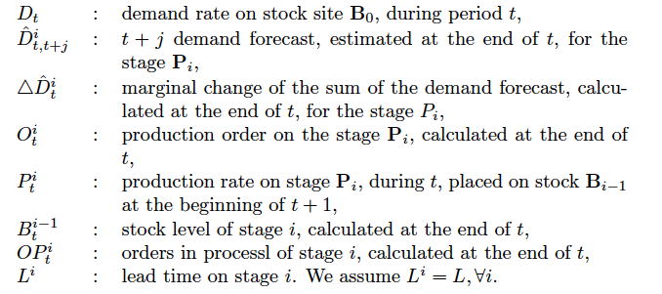
Supply chain management model

Slide 8
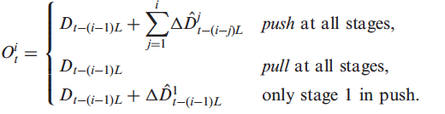
Ordering Methods

Slide 9


Order Equation
Push
Expected work-in-process level
Expected inventory level
Pull

Slide 10
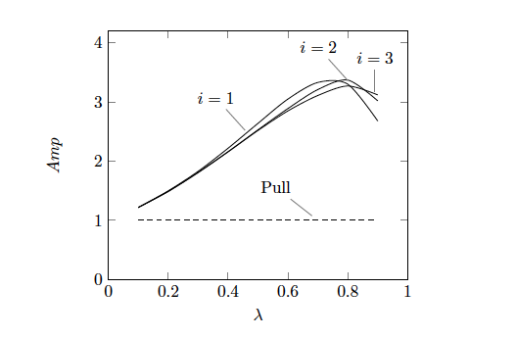

Bullwhip effect
Theoretical !
Figure 3. Amplification at stages 1, 2, 3 (L=2)

Slide 11
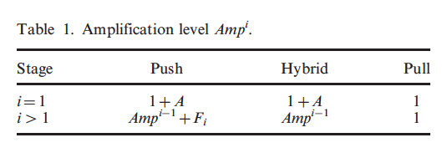
Bullwhip effect
Theoretical !

Slide 12
Research Questions
Behavioural reasons of bullwhip effect?
  Heuristics?
  Biases?
  Method dependent?

Slide 13
Judgment under uncertainty
(Kahneman & Tversky, 1974)
Heuristic mind processing
Adaptation behaviour
Simple probabilistic judgement
Systematic bias

Slide 14
Heuristics
REPRESENTATIVENESS
      Judgement in terms of similarity
HEURISTICS
AVAILABILITY
      Judgment in terms of simplicity of evocation
ADJUSTMENT AND ANCHORING
      judgment in terms of an evocated anchor

Slide 15
Some biases
REPRESENTATIVENESS
    Insensivity to prior probability of outcomes
    Aversion to losses
    Regression toward the mean
AVAILABILITY
    Retrievability of instances
    Imaginability
    Illusory correlation
HEURISTICS
ADJUSTMENT AND ANCHORING
    Insufficient adjustment
    Evaluation of conjunctive and disjunctive events

Slide 16
Experiments
SC model
Uncertain demand process
Experiment #1: no instruction
Experiment #2: pull instruction

Slide 17
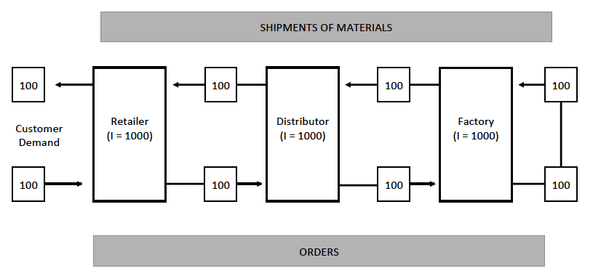
Experiment #1
Figure 4. Experiment setting
Very high initial inventory level (N=1000)
Low variability demand process (μ=100; σ=10%)
Participants are not instructed on inventory management

Slide 18
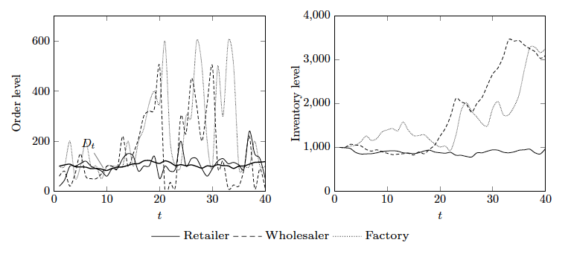
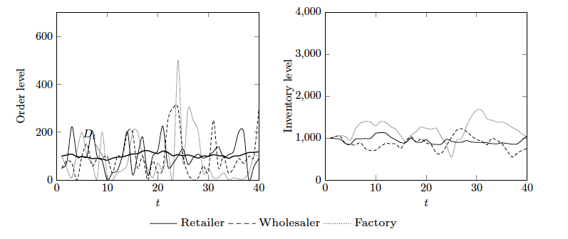
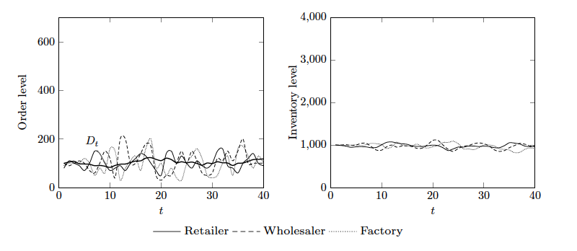
Results #1
Figure 5. Amplification at stages 1, 2, 3 (L=2); the case of 4 groups

Slide 19
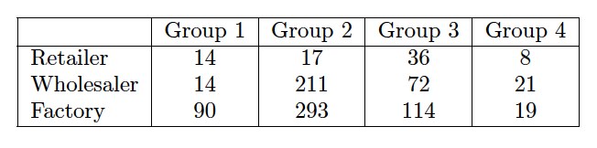
Results #1
Table 2. Amplification (no instruction to participants)

Slide 20
Questions
Push
feedback
Pull
Do people consider feedback?
Disregarding feedback, induce bias?
What biases?

Slide 21
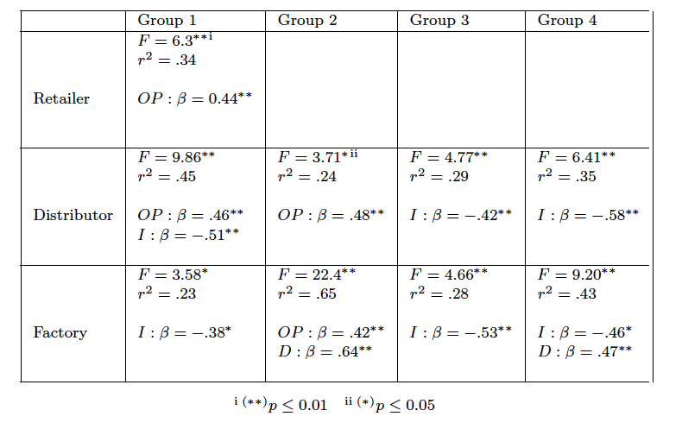
Order predictability #1
Table 3. Multiple regression results (D: demand, I: inventory, OP: work-in-process)

Slide 22
Main results #1
People disregard feedback
They use heuristics and perform very bad
Bias: Substitution of attributes
Question:
  How could people improve performance?

Slide 23
Experiment # 2
Same supply chain setting
Very-high initial inventory level (N=2000)
Medium-variability demand process (μ=200; σ=50%)
Participants are instructed on pull:
  Order = consumption
  Keep inventory under control

Slide 24
Results #2-1

Slide 25
Results #2-2

Slide 26
Results #2-3

Slide 27
Results #2-4

Slide 28
Results #2-5

Slide 29
Results #2-6

Slide 30
Conclusions
Sensitivity to inventory costs?
  Cognitive variables in place
  heuristics and biases
Achievement of the task?
  groups with very bad performance
  Some groups are very good
Facing uncertainty?
  substitution of attribute bias
  Simple dimensional approach (1 or 2)
  Disregarding feedback

Slide 31
Conclusions
Facing the inventory dynamics?
  Over reaction to possible negative scenario
  Anchoring and adjustment heuristic
Future work:
  Levels of perceived uncertainty
  Management people

Slide 32


REFERENCES

